Slide 1
Project 1
Rachel Weber
Fall 2018

Slide 2
Background
The Data:
Prospective study on natural and treated histories of HIV-1 infected men
Up to 8 years of data both from lab tests and quality of life assessments
Subjects were seen annually after beginning HAART
Question of Interest:
How does treatment response differ from year 0 to year 2 between patients who report hard drug use at baseline and those who do not?
Hypothesis:
Drug users may have poor treatment response necessitating more aggressive treatment strategies or enrollment in drug rehabilitation programs
Notes:
Which was motivated by mixed evidence as to whether or nor hard drug use negatively impacted human immune systems

Slide 3
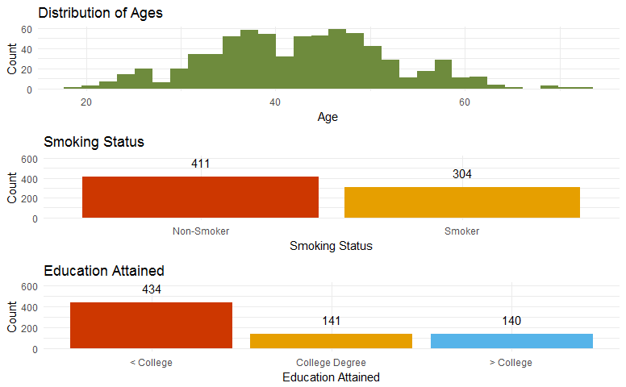
The Data: A Quick Look
474 of 715 patients remained at 2 years with complete baseline information
All had lab measures taken at 2 years
468 of these had complete Mental and Physical Health records

Slide 4
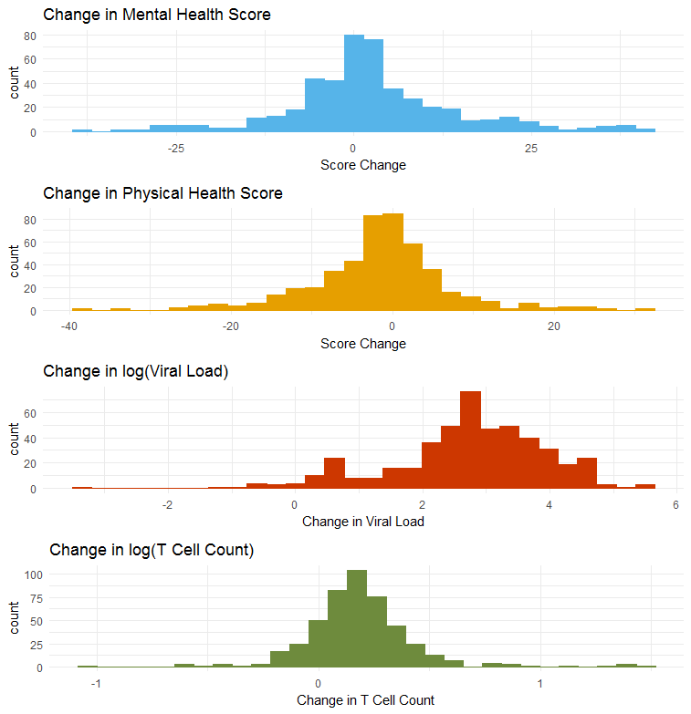
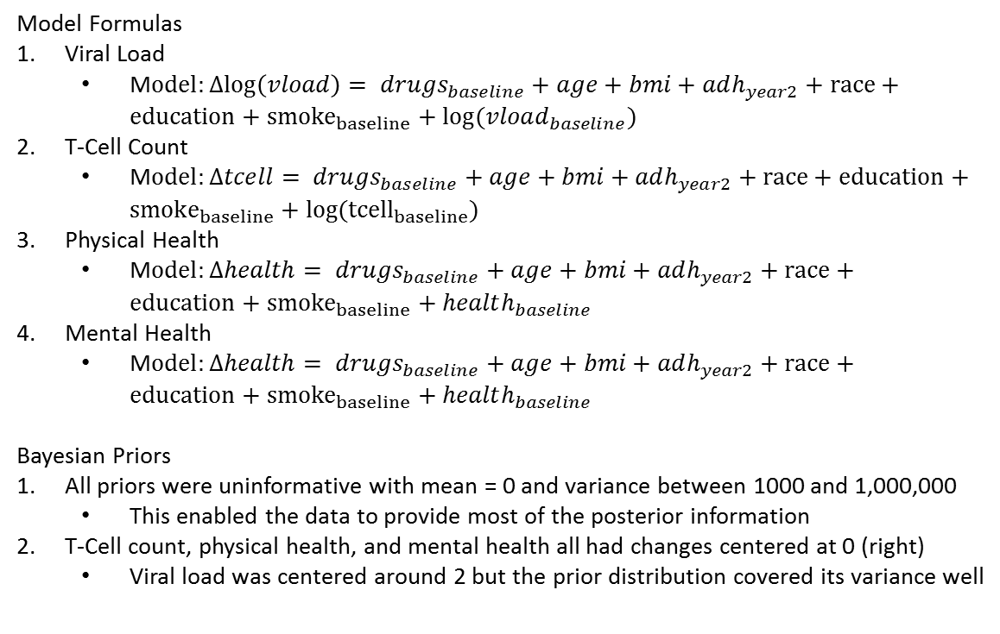
Analysis Plan
Model Formulas
Viral Load
M$odel:Δlog\left(vload\right)= drugs_{baseline}+age+bmi+adh_{year2}+race+education+{smoke}_{baseline}+log⁡(vload_{baseline})$
T-Cell Count
M$odel:Δtcell= drugs_{baseline}+age+bmi+adh_{year2}+race+education+{smoke}_{baseline}+{log(tcell}_{baseline})$
Physical Health
M$odel:Δhealth= drugs_{baseline}+age+bmi+adh_{year2}+race+education+{smoke}_{baseline}+health_{baseline}$
Mental Health
M$odel:Δhealth= drugs_{baseline}+age+bmi+adh_{year2}+race+education+{smoke}_{baseline}+health_{baseline}$
Bayesian Priors
All priors were uninformative with mean = 0 and variance between 1000 and 1,000,000
This enabled the data to provide most of the posterior information
T-Cell count, physical health, and mental health all had changes centered at 0 (right)
Viral load was centered around 2 but the prior distribution covered its variance well

Slide 5
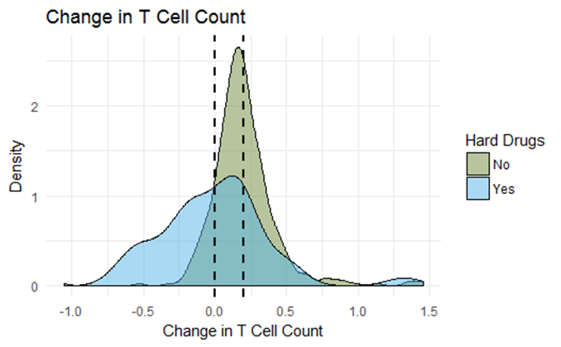
Results - CD4+ Count
Average change: 1.354 log unit
Average for drug users: 1.14 log units
95% CI: 1.074-1.204
Frequentist and Bayesian models agreed almost perfectly
Conclusion:
Hard Drug use decreases the CD4+ count improvement seen in patients over 2 years of participation in the HAART regimen.

Slide 6
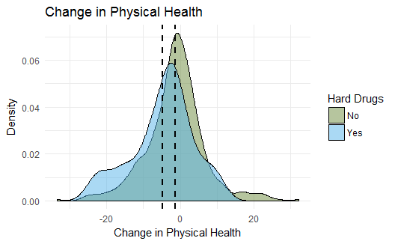
Results - Physical Health
Average change: 17 point increase
Average for drug users: 13.45
95% CI: 10.64-16.26
Frequentist and Bayesian models agreed almost perfectly
Conclusion:
Hard Drug use decreases the Amount of Physical improvement seen in patients over 2 years of participation in the HAART regimen.

